Slide 1
for loop

Slide 2
Objectives
This chapter introduces:
  Basic usage of for loop
  Use break and continue statements in for loop
  Use for loop in the list

Slide 3
for loop
The for loop in Python is used to iterate over a sequence (a list, a tuple, a string) or other iterable objects
  Iterating over a sequence is called traversal
Use the range() function in for loop to control the number of execution
  It gives a sequence of numbers based on the start and stop index given

Slide 4
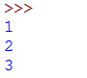
for Single loop
start index
stop index
Syntax:
E.g:
Result:
  for variable_1 in range(range1, range2):
  print()
range () will start from start index, and increment the value by 1 till the stop index
  for a in range(1,4): #single loop
  print(a)
  Start from 1
  Less than 4

Slide 5
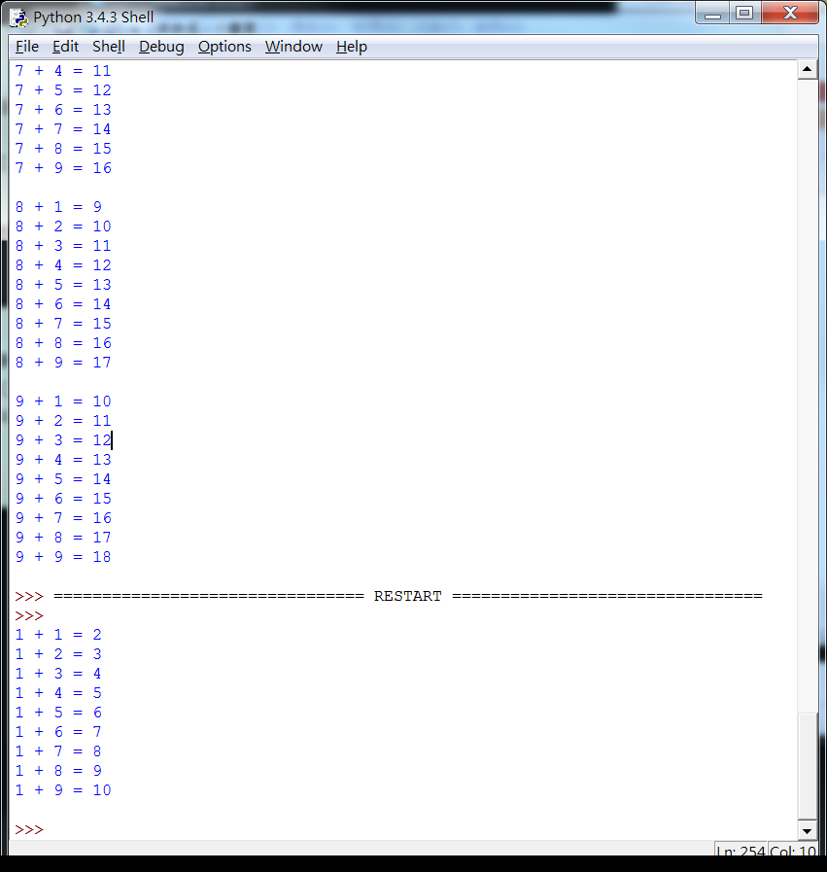
Nested for loops
E.g:
Result:
  for a in range(1,2): # first loop
  for b in range(1,10): # second loop
  print(a, "+",b,"=",a+b)
  print()
  Variable a
  Variable b

Slide 6
break and continue statements

Slide 7
break and continue
'break'
  Used to terminate the current loop and resumes execution at the next statement
‘continue‘
  Used to return the control to the beginning of the for/while loop

Slide 8
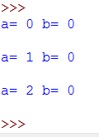
break
E.g:
Result:
  for a in range(0, 3):
  for b in range(0, 3):
  print("a=",a,"b=",b)
  break;
  print("loop") #This will not be executed
  print()

Slide 9
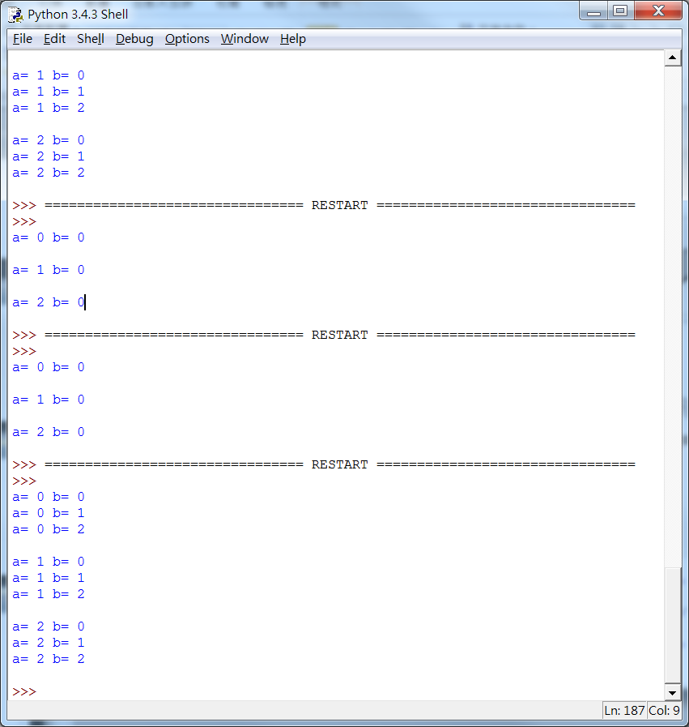
continue
E.g:
Result:
  for a in range(0, 3):
  for b in range(0, 3):
  print("a=",a,"b=",b)
  continue;
  print("loop")#This will not be executed
  print()

Slide 10
for loop with a list
for loop can be used to display the data in a list
  The list can be used to contain integer variables, characters, and other different data types

Slide 11
for loop with a string
  string = "Hello"#Declare a string “Hello”
Characters stored in a list:
Index value | 0 | 1 | 2 | 3 | 4 | 5
Character | H | e | l | l | o | \0

Slide 12
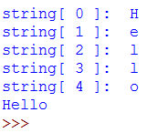
for loop with a string
E.g:
Result:
  string = "Hello"
  for num in range(0,5):
  print ("string[",num,"]: ", string[num])
  print (string)
  Displaying all characters one by one
  Use print (string) to display whole string

Slide 13
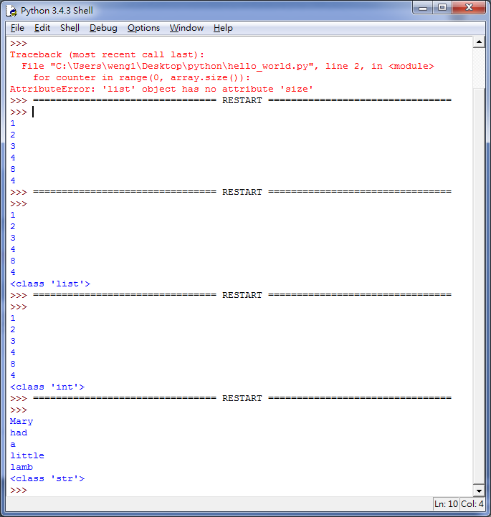
for loop with a list
E.g:
Result:
  array = ["Mary", "had", "a", "little", "lamb"]
  #len(array) is used to get the size of the array
  for counter in range(0, len(array)):
  print(array [counter])
  print(type(array[0])) #Display the type of the array[0]

Slide 14
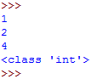
for loop in the list
E.g:
Result:
  array = [1,2,4]
  for counter in range(0, 3):
  print(array [counter])
  print(type(array[0]))#Display the type of the array[0]

Slide 15
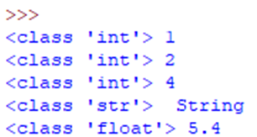
for loop in the list
E.g:
Result:
  array = [1,2,4," String ",5.4]
  for counter in range(0, 5):
  print(type(array[counter]),array [counter])
  #Display the type of the array[counter] and the data in the list

Slide 16
Sources
References:
  http://openhome.cc/Gossip/Python/IOABC.html
  http://www.pythondoc.com/pythontutorial3/introduction.html
  http://pydoing.blogspot.tw/2011/01/python-operator.html
  Python深入淺出程式設計

Slide 17

Exercise 1
Design a program that will ask the user to input a text t and a character c, and then print the characters in t, not including c.
Input:
  Text : “hello world, welcome to Python!”
  Character : “e”
Result:

Slide 18
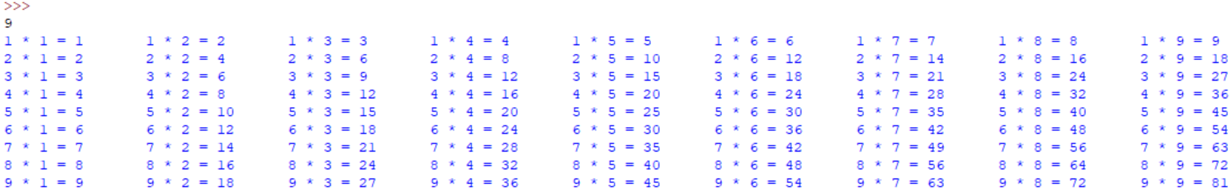
Exercise 2
Design a program that will ask the user to input a number k and then display a k times table.
Input: 9
Result:

Slide 19

Exercise 3
Write a program that can enter two integers N1 and N2, and then display the greatest common divisor and the least common multiple of N1 and N2 on the screen.
Input : 15 10
Result:

Slide 20
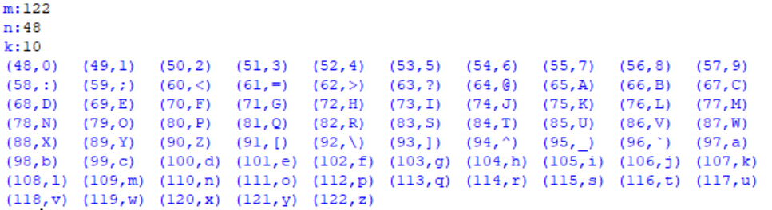
Exercise 4
Please write a program that will ask the user to input three integers m,n,k (0 <= m, n <= 255, and k>0), and then print the characters for the ASCII values from min(m,n) to max(m,n), where each line on the screen has at most k pairs of ASCII value and the corresponding character.
Result:
Hint: Use the chr() function to get character from its corresponding ASCII value

